Slide 1

DATATYPES

Slide 2
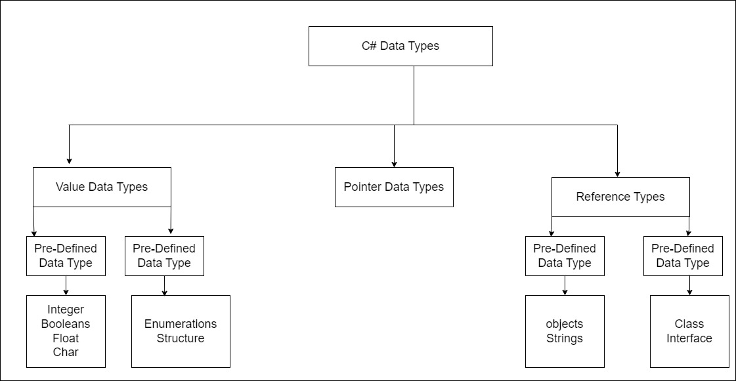

Slide 3
C# Data types
There are three types of data types in the C# language :
Value Data Types
Reference Data Types
Pointer Data Types

Slide 4
What is Value Data types in C#
The data type which stores the values directly in the memory oc called the Value Data Types.
This include:
Int – stores numbers e.g. 1,23
Char – stores alphabets/letter – ‘a’ , ‘b’
Boolean – stores true/false
Float - stores Floating point numbers

Slide 5
Byte vs sByte
Byte is a .NET datatype that is used to represent a 8 bit unsigned integers( unsigned means positive values) – it can store any value from 0 to 255.
Sbyte represents both positive an negative values- it can store any value from -128 to 127

Slide 6
What is a char Datatype
Char is a 2-byte length data type that can contain Unicode data. You can represent Unicode characters as UTF-8 and UTF-16 and so on .
AS per the definition of char , it represents character as a UTF-16 code unit.
Char is a signed data type that can store only positive numbers.
But byte and char seems to achieve the same things so why do we need to use 16-Bit for one and 8 byte for the other(why not use byte and save on memory)
See, using byte data type we can only represent a maximum of 256 characters or you can say ASCII values. Byte will hold a maximum of 256 symbols/character, after 256 symbols/character, if we want to store some extra symbols like the Hindi alphabet, Chinese alphabet, or some special symbols which are not part of ASCII Characters, then it is not possible with the byte data type, because we already store the maximum symbols or characters. So, char is a Unicode character representation, it is having 2 Byte length and hence we can store the regional symbols, extra symbols, and special characters using the char data type in C#.

Slide 7
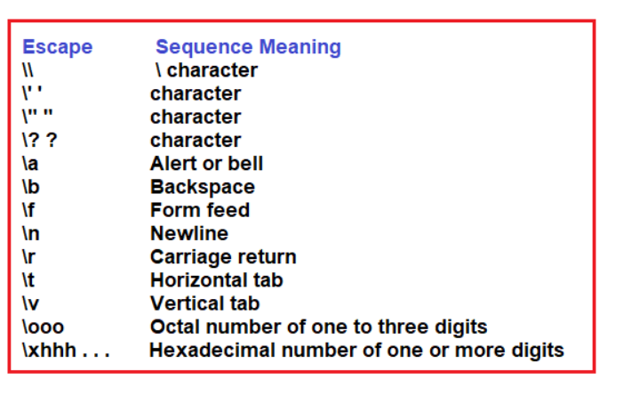
Character Literals using Escape Sequence

Slide 8
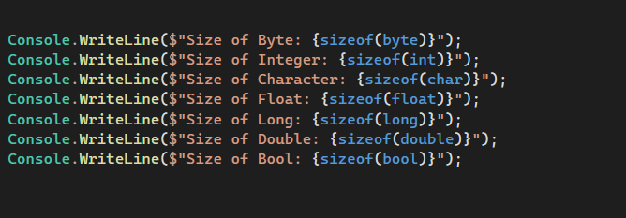
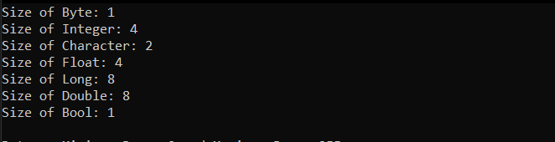
How to Get the Size of Pre-Defined Datatypes in C#

Slide 9
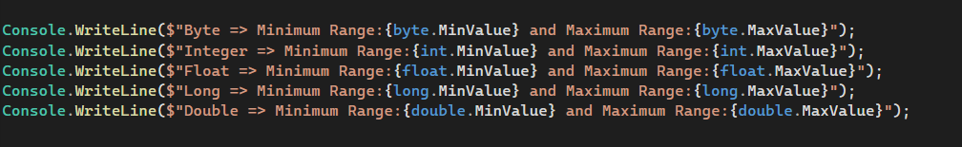
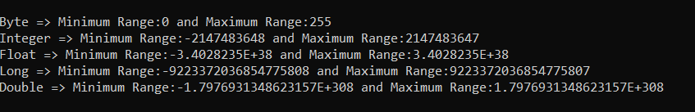
How to Get the Minimum and Maximum Range of Values of Built-in Data Types in C#?

Slide 10
